Slide 1

Enterprise Network Design CSCI-6649-03 Fresh Connections (Grocery chain network)
PRESENTED BY:
Neha Singam (00770807) Nishchal Sreevathsa (00803363) Pavan Kumar Davar (00770542) Nitesh Yalamanchili (00794536) Chandralekha Podili (00770060)
PROFESSOR:
Luis Rivera.

Slide 2
Contents
Introduction
Product Research Area
Challenges
Implementation of Phase-1
Implementation of Phase-2
Implementation of Phase-3
Implementation of Phase-4
Cost Estimations
Conclusions

Slide 3
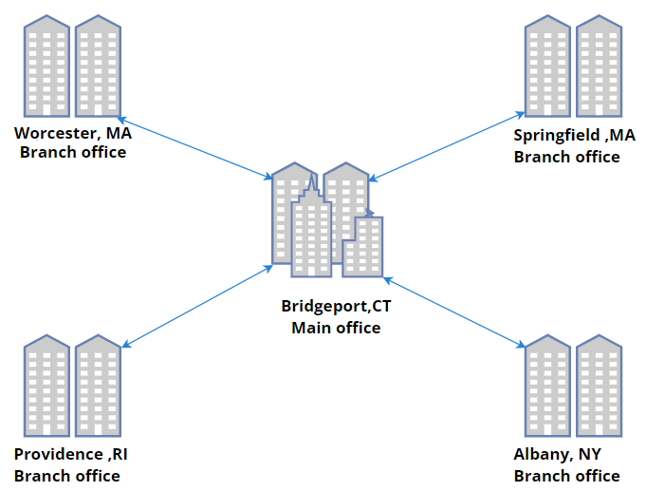
Introduction
Fresh Connections is a dynamic and growing grocery chain network that provides customers with high-quality and fresh products at affordable prices.
It has been developed by the Cisco packet tracer.
The network aims to provide customers with a seamless shopping experience, which also meeting the business and technical goals of the company.
Outline of the Network

Slide 4
Product Area Research
Location | Number of Employees | Number of Devices | Estimated Number of Customers | Website Traffic (Daily) | Average Network Traffic (Mbps)
Store 1 | 25 | 15 | 500-700 | 1500-2000 | 100
Store 2 | 30 | 20 | 700-900 | 2000-2500 | 150
Store 3 | 20 | 15 | 400-600 | 1000-1500 | 80
Store 4 | 35 | 25 | 800-1000 | 2500-3000 | 200
Store 5 | 25 | 15 | 500-700 | 1500-2000 | 100
Fresh Connections is a grocery chain store with over 5 stores in the USA.
The website receives over 5000 visitors and 2000+ online orders per day.
The existing stores have 20-35 employees each, with a total of 5 corporate spaces.
The head office in Bridgeport will have around 30 employees and 20 devices, while the branch offices will have around 20 employees and 15 devices each.
The number of current clients/users per location is not specified.

Slide 5
Challenges in the grocery industry
One major challenge is the high cost of operating physical stores, including rent, utilities, and labor costs. This can make it difficult for grocery stores to maintain profitability, especially in the face of competition from online retailers and discount stores.
Changing shopping patterns: The rise of e-commerce and mobile shopping has changed the way people shop for groceries. Online ordering and home delivery are becoming more popular, which puts pressure on traditional stores to adapt.
Supply chain complexity: Grocery supply chains are highly complex, involving many different suppliers, distributors, and delivery routes. This complexity can lead to challenges in managing inventory and ensuring timely delivery.
Changing customer preferences: Customer preferences are evolving, with an increased emphasis on health, sustainability, and convenience. Grocers need to be able to adapt to these changing preferences in order to stay competitive

Slide 6
Phase-1 : Customer Goals
1.Convenience: Customers want a convenient shopping experience that is fast, easy, and tailored to their needs.
2.Personalization: Customers want a personalized shopping experience that offers recommendations and promotions based on their preferences and past purchases.
3.Quality: Customers want high-quality products that are fresh, healthy, and sourced from reputable suppliers.
4.Sustainability: Customers want environmentally sustainable products and packaging that minimize their impact on the planet.
By understanding these goals, Fresh Connections can design technology solutions that meet the needs and expectations of its customers.

Slide 7
Phase-1: Business Goals
1.Increased sales: Fresh Connections wants to increase its sales by providing customers with a better shopping experience and offering a wider range of products.
2.Improved efficiency: Fresh Connections wants to improve its operational efficiency by streamlining its supply chain, reducing waste, and optimizing inventory management.
3.Competitive advantage: Fresh Connections wants to gain a competitive advantage by providing a differentiated customer experience that sets it apart from its competitors.
4.Business growth: Fresh Connections wants to grow its business by expanding into new markets and increasing its market share.
By understanding these goals, Fresh Connections can design technology solutions that support its business objectives. For example, the proposed cloud infrastructure can help Fresh Connections optimize its inventory management and streamline its supply chain, which can improve its efficiency and reduce waste. It can also provide data analytics tools to help Fresh Connections make informed decisions and gain a competitive advantage.

Slide 8
Phase-1: Technical Goals
1.Fresh Connections needs a network infrastructure that can support its business processes and enable effective communication and collaboration between its employees and branches.
2.Fresh Connections also needs a network infrastructure that is secure, reliable, and scalable.
3.Fresh Connections needs to implement network services such as email, FTP, DNS, web servers, and DHCP to support its business operations.
4. Fresh Connections also needs to implement DSL modems at each sub-branch to connect to the internet.

Slide 9
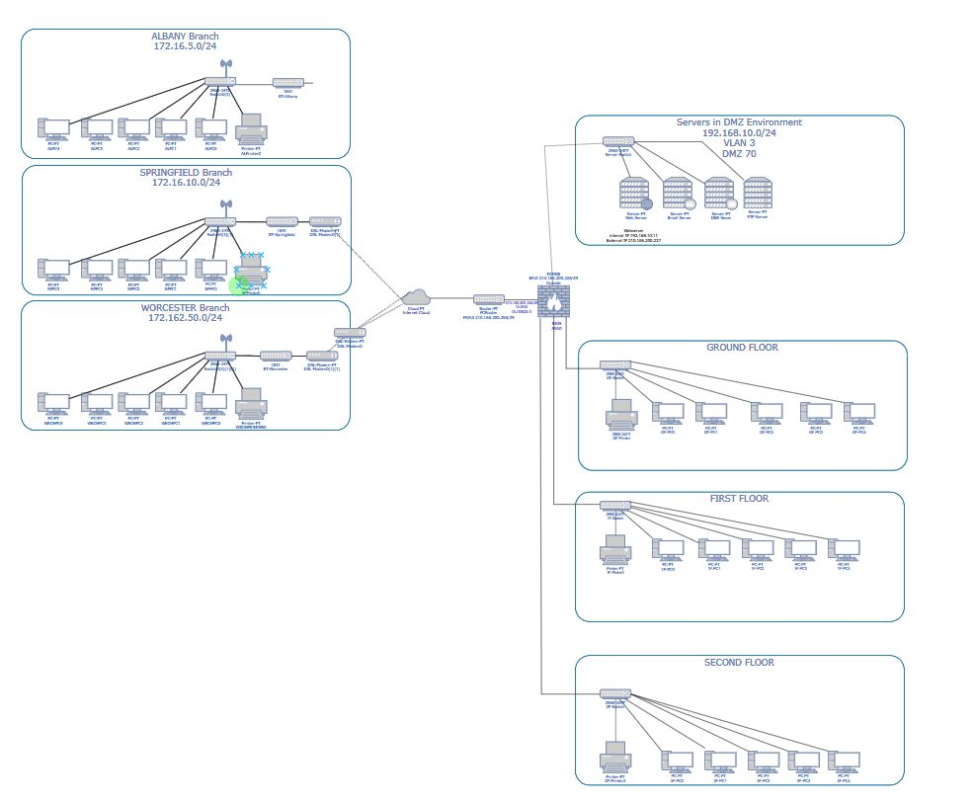
Phase-1: Logical Network Design

Slide 10
Phase-2: VLAN Topology
VLANs will be used to improve network performance and security by segmenting traffic and isolating network issues.
Grouping devices based on their function, location, or security requirements using VLANs will optimize routing and reduce downtime.
A hierarchical network design will be used with core, distribution, and access layers for optimal performance and scalability.
A VLAN-based network management strategy will be used for simplified management and enhanced security.

Slide 11
Phase-2 : List of IP Addresses
Location | Number of Devices | IP-Addressing | Subnet | External IP-addressing
Bridgeport (Main Branch) | 20 | 192.168.1.1/24 - 192.168.1.64/24 | 255.255.255.0 | -
Albany | 15 | 172.16.5.0/24 - 172.16.5.64/24 | 255.255.255.0 | 20.110.24.0/30
Springfield | 15 | 172.16.10.0/24 - 172.16.10.64/24 | 255.255.255.0 | 20.110.25.0/30
Worcester | 15 | 172.162.50.0/ 24 - 172.162.50.64/24 | 255.255.255.0 | 20.110.35.0/30
Providence | 15 | 172.16.15.0/24 - 172.16.15.64/24 | 255.255.255.0 | 20.110.36.0/30

Slide 12

Phase-2: Security and Network Management Strategies
Firewall: FreshConnections uses a firewall to protect its network from unauthorized access and attacks. The firewall can filter incoming and outgoing network traffic and block any suspicious activity.
DMZ: FreshConnections uses a Demilitarized Zone (DMZ) to isolate its public-facing servers and services from the rest of the network. This helps protect against external attacks and ensures that any security breaches are contained.
Cloud Services: FreshConnections uses cloud services to store data and run applications in a virtual environment. This can help reduce the need for on-premises hardware and provide scalability and flexibility.

Slide 13
Phase 3: Network Design-Routing
1. Static Host Configuration Protocol:
Manually addressing unique address to each and every device.
Static Addressing is for less number of devices.
new device -> select "manual" configuration option to enter in the IP address, ->subnet mask -> default gateway -> and the DNS server(s).
Servers are configured with Static IP Addresses.
DNS Server IP Address: 192.168.10.12
FTP Server IP Address: 192.168.10.13
Web Server IP Address: 192.168.10.11
Email Server IP Address: 192.168.10.14

Slide 14
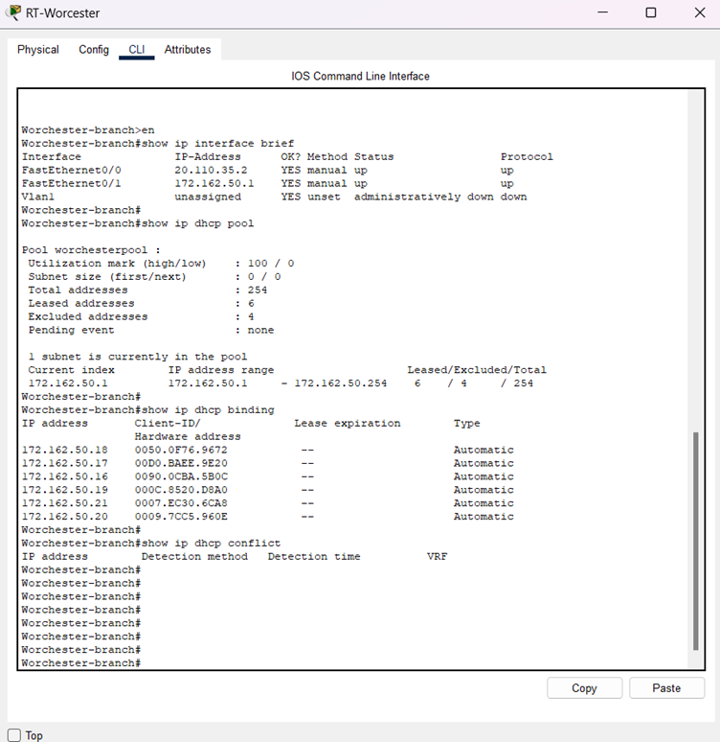
Phase 3: Network Design-Routing
2. Dynamic Host Configuration Protocol(DHCP):
The server assigns an unused location to the new devices whenever are connected to the network.
Dynamic Addressing is for more devices.
The server tracks the used and unused addresses for the devices.
IP address may not be the same when the device goes offline and reconnects to the server.
In this Network DHCP is used to assign IP address to end devices in the network.
In the network design, we used OSPF dynamic routing between all sites.
OSPF routing protocol used to exchange routing information between routers within a network. It is commonly used in large enterprise networks because it provides efficient and scalable routing, supports load balancing, and can adapt to changes in network topology quickly.

Slide 15

Phase-3: Physical Network Devices
Cisco Catalyst 2960 Switches
Cisco 1841 Series Routers
Network Cables(Copper Straight Through, Copper Cross over, Serial DCE and Serial DTE etc)
Network Interface cards
Cisco 5505 ASA Firewall
VLAN
DSL Modems
Cisco Servers
Printers
PC’s
Cloud

Slide 16
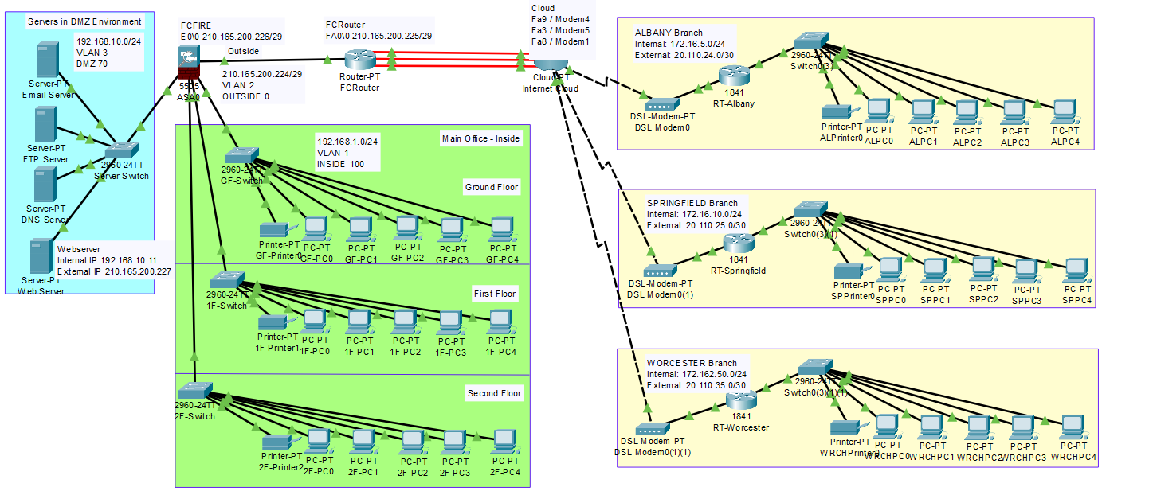
Phase-4: Proposed Network Design Map

Slide 17
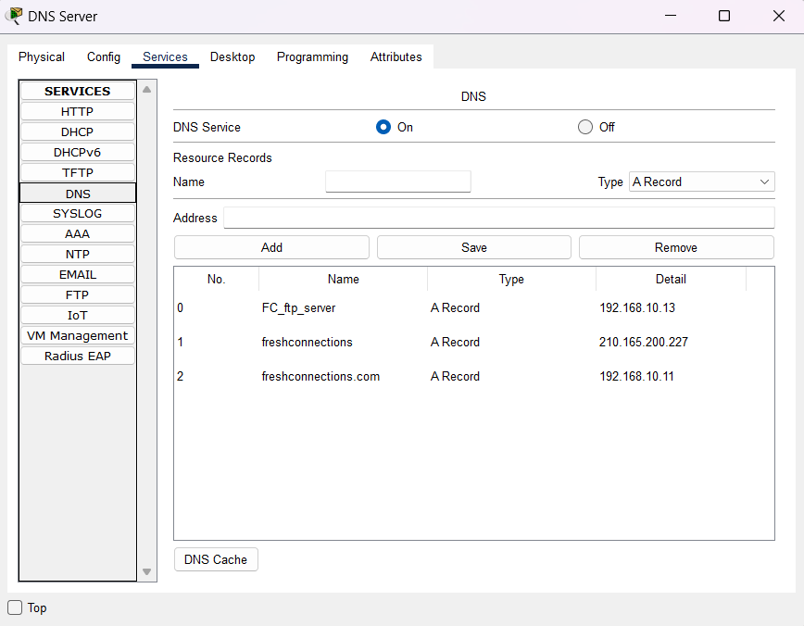
Phase-4: Network Testing-DNS Server
In our network:
Ip address – 192.168.10.12
Website – www.freshconnections.com

Slide 18
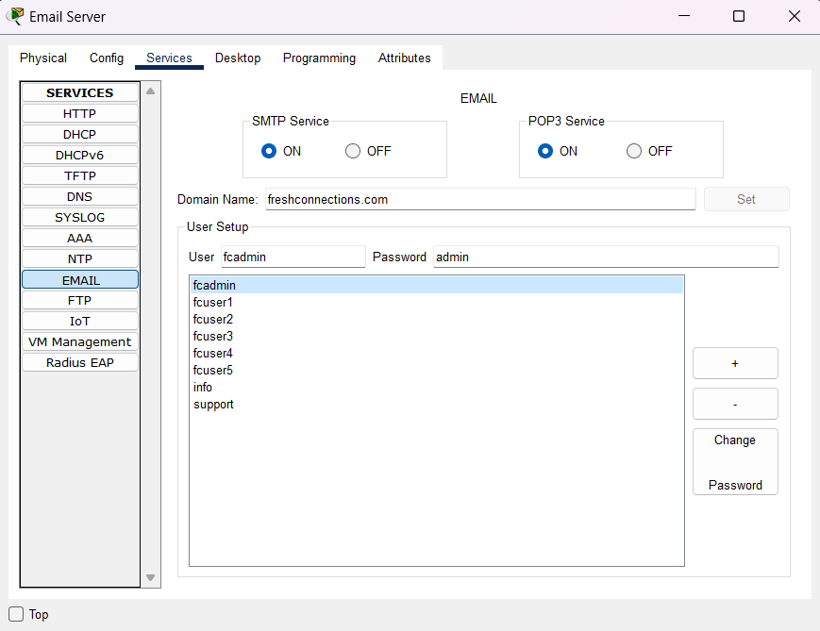
Phase-4: Network Testing-Email Server

Slide 19
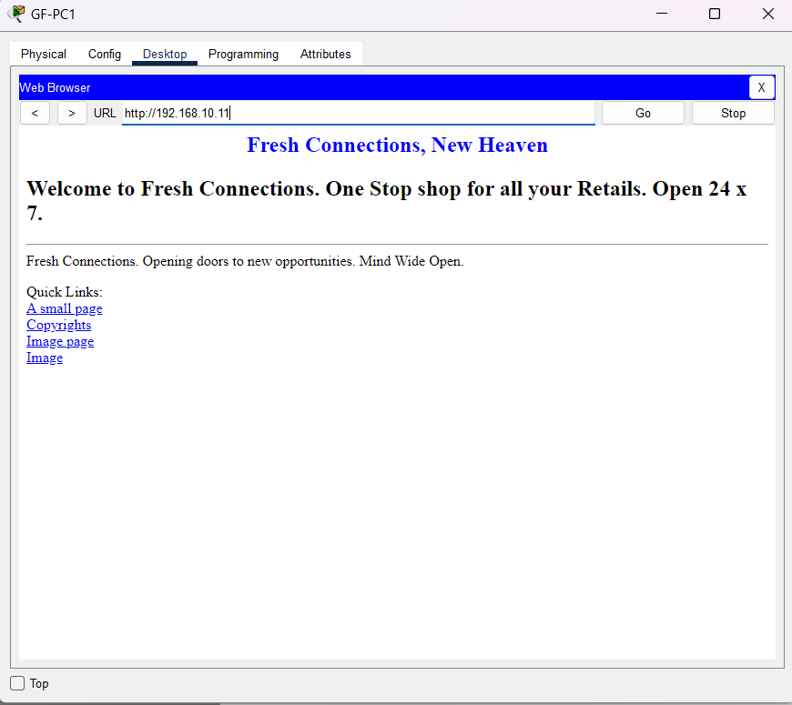
Phase-4: Network Testing-Web Server

Slide 20
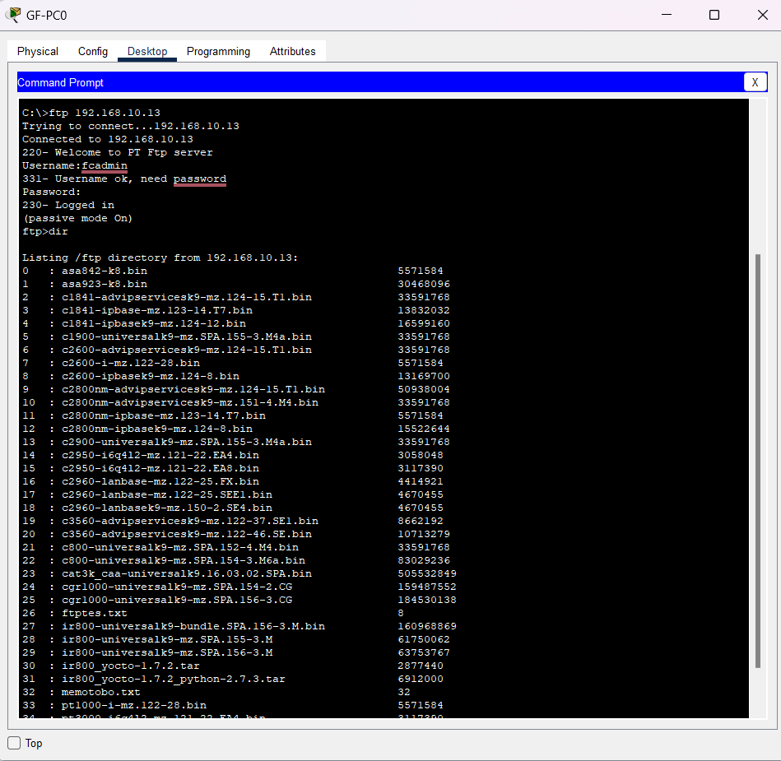
Phase-4: Network Testing- FTP Server

Slide 21
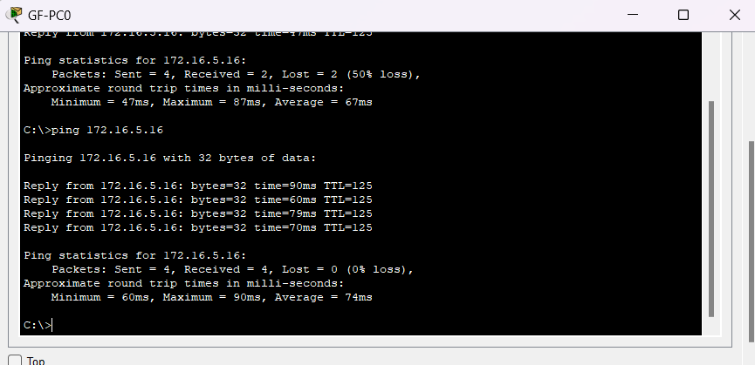
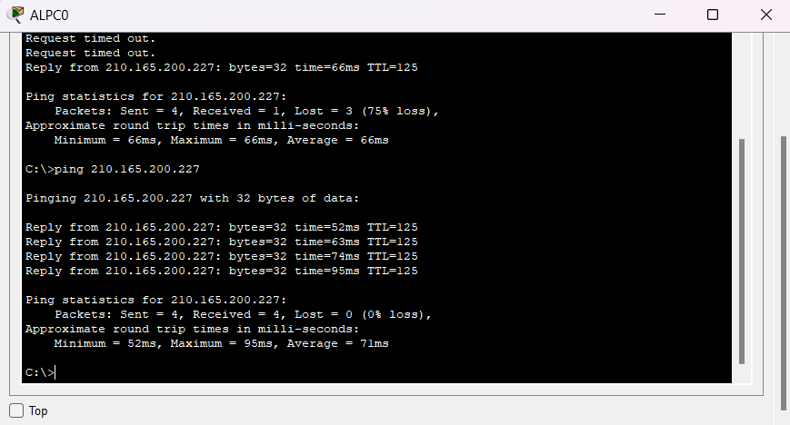
Pinging from Sub-Branch to Web Server
Pinging from Main Branch to Sub- Branch

Slide 22
Cost Estimation
Product | Quantity | Price | Total Cost
Routers | 5 | $1200 | $6000
Switches | 7 | $1000 | $7000
Servers | 4 | $5000 | $20000
PC’s | 50 | $700 | $35,000
Cloud services | 1 | $500/month | $6000/year
Printers | 7 | $500 | $3500
Ethernet cables | 200 | $15 | $3000
Cross over cables | 50 | $15 | $750
Internet | - | $1000/month | $12,000/year
DSL-Modems | 4 | $60 | $240
Inventory management system | 1 | $5000 | $5000
Total |  |  | $98,490
Labor cost | - | - | $90,000
Training cost | - | $2500 | $2500
Total cost estimation |  |  | $1,90,990

Slide 23
Conclusion
Fresh Connections' technology needs are critical to its business success, and the grocery industry is facing significant challenges that require innovative solutions.
A cloud-based infrastructure provides a scalable, secure, and centralized solution for Fresh Connections' data management and inventory processing needs.
The proposed solution aligns with Fresh Connections' customer, business, and technical goals and can address the challenges faced by the grocery industry.
The average load for this design is about 100 MBPS, and it supports up to 1.0 GBPS.
This Design has 99.9999% uptime.

Slide 24
Thank you

